Slide 1
Name:Prithika N Register No:111725110063 Branch:EEV

Slide 2


Software Requirements Specification for Food Security
This presentation provides a comprehensive overview of the Software Requirements Specification (SRS) for a project dedicated to improving food security. It outlines the project's main objectives, essential functionalities, user requirements, and implementation strategies designed to effectively tackle food-related challenges. The goal is to ensure a sustainable and reliable food supply for all.

Slide 3




Introduction to Food Security
1
Definition of Food Security
Food security exists when all people, at all times, have physical, social, and economic access to sufficient, safe, and nutritious food to meet their dietary needs for an active life.
2
Importance of Food Security
Ensuring food security is crucial for health, economic stability, and social cohesion, as it affects poverty reduction and community development.
3
Global Challenges
Factors such as climate change, population growth, and economic disparities pose significant challenges to achieving food security worldwide.

Slide 4



Project Objectives
Data-driven Decision Making
2
Implementing data analytics to assess food supply chains and predict shortages.
Enhancing Accessibility
The project aims to improve access to food for vulnerable populations through technology-enabled solutions.
1
Sustainability Practices
3
Incorporating sustainable agricultural practices that focus on resource efficiency.

Slide 5



User Requirements Analysis
1
End-User Identification
Farmers, food suppliers, policymakers, and consumers will use the solution.
2
User-Friendly Interface
An intuitive interface for users with varying tech proficiency.
3
Multilingual Support
The platform will support multiple languages.

Slide 6


Functional Requirements Overview
Food Supply Monitoring
Resource Allocation
Reporting Capabilities
Track food supply levels in real-time.
Optimize allocation based on demand forecasts.
Access to detailed reports on food trends.

Slide 7



Non-Functional Requirements
Security
2
Data protection measures against unauthorized access are essential.
Performance
The system must handle high data transactions efficiently.
1
Scalability
3
The software should grow with future demands using cloud solutions.

Slide 8


Implementation Strategy
1
Agile Development Methodology
Employ agile practices for iterative development.
2
Stakeholder Engagement
Ongoing communication to incorporate feedback.
3
Pilot Testing
Initial deployments to validate functionalities.

Slide 9
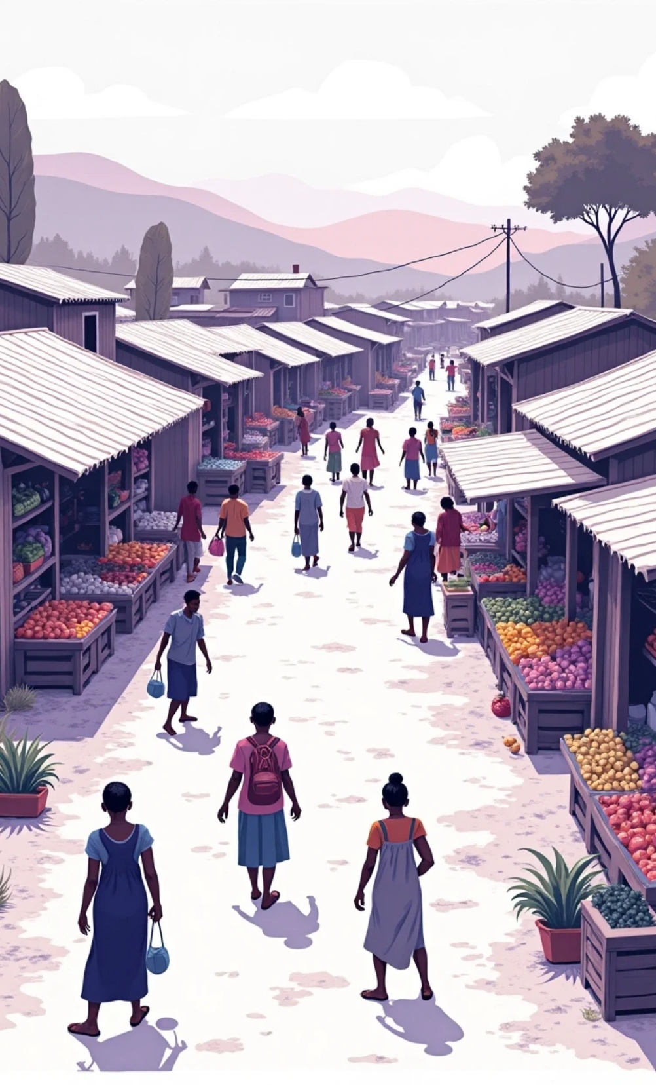
Challenge Analysis
Technology Adoption
Assessing the barriers to technology adoption among users, especially in rural areas, and implementing strategies to mitigate these issues.
Cultural Sensitivity
Understanding cultural differences in food consumption and distribution practices to better tailor solutions for diverse populations.
Logistical Constraints
Addressing logistical challenges in food distribution, particularly in remote or underserved areas, where infrastructure may be lacking.

Slide 10



Risk Management Strategies
Response Strategies
Developing contingency plans that include user training programs and responsive technical support.
Identifying Risks
Regular Monitoring
Potential risks include technology failures, user resistance, and misinformation about the system's purpose.
Continuous assessment of each risk area will be conducted to adapt strategies and maintain project momentum.
2
1
3

Slide 11

Partnerships and Collaboration
Engaging NGOs
Collaborating with non-governmental organizations focused on food security to leverage their expertise and outreach capabilities.
Government Support
Seeking partnerships with government bodies to ensure compliance with regulations and enhance project credibility.
Private Sector Engagement
Involving private companies in supply chains to create synergies that will benefit food distribution networks and technology deployment.

Slide 12

Technological Framework
1
Cloud Computing Solutions
Utilize cloud infrastructure for scalability and flexibility, ensuring the system can handle varying loads and data securely.
2
Mobile Application Development
Building intuitive mobile applications to ensure accessibility for users in remote areas, allowing real-time data entry and updates.
3
GIS Technology Utilization
Implementing Geographic Information Systems (GIS) to visualize data pertaining to food distribution and agricultural practices geographically.

Slide 13



Funding and Budget
This section outlines key areas related to funding and budget management, ensuring the project is sufficiently supported financially while maintaining effective cost management and resource utilization.
Cost Management
2
Developing a framework for ongoing cost evaluations and financial forecasts to ensure the project remains within budget.
Budget Allocation
Identifying funding sources, including grants, public-private partnerships, and crowdfunding to ensure comprehensive financial support.
1
Resource Utilization
Identifying ways to optimize resource use without compromising the quality of deliverables in the project.
3

Slide 14



Evaluation Metrics
Success Indicators
User Feedback Mechanisms
Long-term Assessment
Defining specific metrics to measure the impact of the system on food security in target areas, such as reduced food waste and improved access.
Implementing channels for users to provide ongoing feedback, ensuring that the system evolves based on real user experiences.
Establishing a framework for long-term evaluation of the project's sustainability and adaptability to changing food security challenges.

Slide 15


Timeline and Milestones
Project Phases
Final Review and Launch
Including planning, development, pilot testing, and full rollout.
Comprehensive review before the official launch.
1
2
3
Milestone Tracking
Establishing measurable milestones for tracking progress.

Slide 16
Future Directions
Technological Innovations
Researching emerging technologies, such as AI and blockchain, to incorporate advanced functionalities that enhance food security management.
2
Scaling the Solution
Exploring possibilities for expanding the project beyond initial regions to include additional communities facing food insecurity.
1
Policy Advocacy
3
Working with policymakers to create supportive regulations and frameworks that promote food security initiatives and technology utilization.

Slide 17

Conclusion
1
Project Significance
This SRS outlines the need for a comprehensive solution to address food security challenges and the strategic approach to achieve project objectives effectively.
2
Collaborative Efforts
Emphasizing the importance of collaborations among various stakeholders to create a holistic and inclusive approach to food security.
3
Call to Action
Encouraging potential partners and users to engage with the project to contribute to a sustainable solution that ensures food security for all.

Slide 18



Key Aspects of Food Security Research
Literature Review
Case Studies
Regulatory Frameworks
A comprehensive review of existing literature on food security, technology interventions, and project management practices relating to food supply chains.
Examination of successful food security initiatives globally that leverage technology and collaboration.
An overview of relevant policies and regulations that impact food security and technological solutions in different regions.

Slide 19
Acknowledgments
Advisory Board
Acknowledgment of the advisory board for their insights and guidance throughout the project development stages.
2
Project Team
Recognition of team members and contributors who played a vital role in developing the project objectives and SRS.
1
Community Support
3
Appreciation for community members and organizations that have supported the initiative through feedback and resources.

Slide 20
Thank You

